Slide 1



SNMP CONFIGURATION
GROUP NUMBER

Slide 2
OVERVIEW
The SNMP Service, when configured for an agent, generates trap messages that are sent to a trap destination, if any specific events occur.
For example, you can configure the SNMP service to send a trap when it receives a request for information that does not contain the correct community name and does not match an accepted host name for the service.

Slide 3
SNMP Agent
The agent is a program that is packaged within the network element
Enabling the agent allows it to collect the management information database from the device locally and makes it available to the SNMP manager
SNMP agent’s key functions
- Collects management information about its local environment
- Stores and retrieves management information
- Signals an event to the manager
- Acts as a proxy for some non–SNMP manageable network node

Slide 4
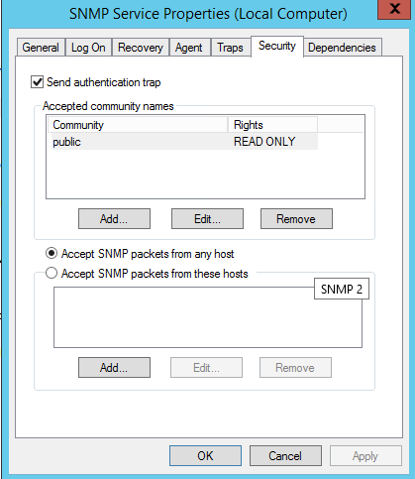
CONFIGURING SNMP agent IN WINDOWS XP
Click Start, point to Settings, click Control Panel.
Under Administrative Tools, click Services.
In the details pane, right-click SNMP Service and select Properties.
In the Security tab, select Send authentication trap if you want a trap message to be sent whenever authentication fails.
Under Accepted community names, click Add.
Under Community Rights, select a permission level for this host to process SNMP requests from the selected community.
In Community Name, type a case-sensitive community name, and then click Add.
Specify whether or not to accept SNMP packets from a host:
To accept SNMP requests from any host on the network, regardless of identity, click Accept SNMP packets from any host.
To limit acceptance of SNMP packets, click Accept SNMP packets from these hosts, click Add, type the appropriate host name, IP or IPX address, and then click Add again.
Click Apply to apply the changes.

Slide 5
Configuring SNMP traps
Click Start, point to Settings, click Control Panel.
Under Administrative Tools, click Services.
In the details pane, right-click SNMP Service and select Properties.
In the Traps tab, under Community name, type the case-sensitive community name to which this computer will send trap messages, and then click Add to list.
Under Trap destinations, click Add.
In the Host name, IP or IPX address field, type host name or its IP address of the server to send the trap and click Add.
Repeat steps 5 through 7 until you have added all the communities and trap destinations you want.
Click OK to apply the changes

Slide 6
SNMP Implementation
Monitoring Tools

Slide 7
Overview
Simple Network Management Protocol is implemented using monitoring tools to manage several devices connected to a network.
SNMP monitoring tools support this feature by providing security.
To manage devices, SNMP equips network administrators to access, collect, organize and modify data and information about a device's behaviour.
The SNMP monitoring tools allow receiving and configuration alerts, monitoring device performance metrics, undertaking active polling and offering granularity, accuracy, and efficiency to determine network health and performance.

Slide 8



ManageEngine OpManager: The tool's processing element manages approximately 300 messages per second. ManageEngine OpManager works as a comprehensive SNMP tool as it is compatible with Windows and Linux platforms. Tools provided to set multi-level thresholds to provide higher security and security breaches warnings, and features such as network mapping, status monitoring, traffic analysis, and utility utilities. customizable on its dashboard.
Kaseya Network Monitor: Kaseya Network Monitor is one of the best SNMP monitors for Windows. The platform is agentless and integrates with Kaseya VSA. The range of monitoring services it offers, such as log, SNMP trap, file and directory, and mail QoS monitoring, can be used to establish an ideal network management system.
Pulseway IT Management Software: The Management Software enables Windows, Mac and Linux users to take advantage of monitoring features for various network elements. Again, they can run commands directly in the terminal and perform actions such as restarting services, applying updates, and managing transactions from their mobile devices. It can improve many of its features, especially alert systems that currently do not offer any customization to receive notifications.

Slide 9


Spiceworks Network Monitor: The customization feature is what gives Spiceworks a serious advantage over other free SNMP managers on the market. However, if they need a sophisticated SNMP monitoring system for a large network, they would probably be better off with a more advanced and paid tool.
IPswitch Whatsup Gold: Whatsup Gold is an excellent tracking system by the Ipswich brand. It can display current status information for use on another system and automatically switch network devices to maintenance mode before applying any permanent changes.
Logic Monitor: The Logic Monitor tool combines the functionality of SNMP with data from NetFlow and provides a comprehensive view of network performance. The tool relies on a cloud-based system, as it is more beneficial to combine data from multiple sites. It uses the software as a service approach and allows users to access and monitor devices from anywhere as the information collection servers are located offsite.

Slide 10
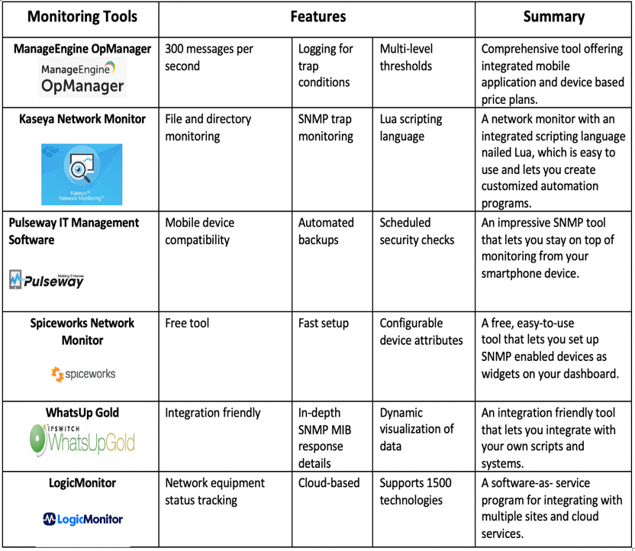
Features and applications

Slide 11
Conclusion
Monitoring network performance is an essential part of any network management system and its network functions. Most of these systems build using SNMP, which helps administrators gain a new perspective on network performance. SNMP provides management systems with the ability to easily collect data for analysis.

